Slide 1
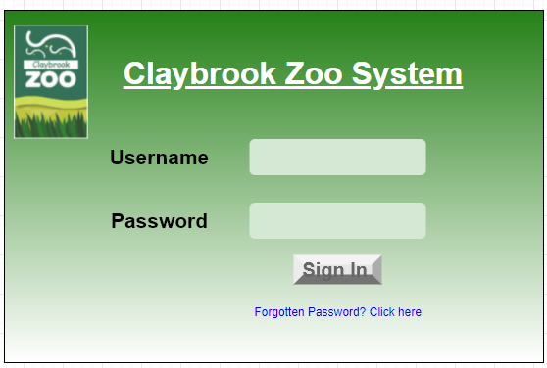
Start
System Activity Event Diagrams
Display
Logging into the system
User enters details
Correct username password
Invalid login details
Successful validation
Display 2
Stop

Slide 2
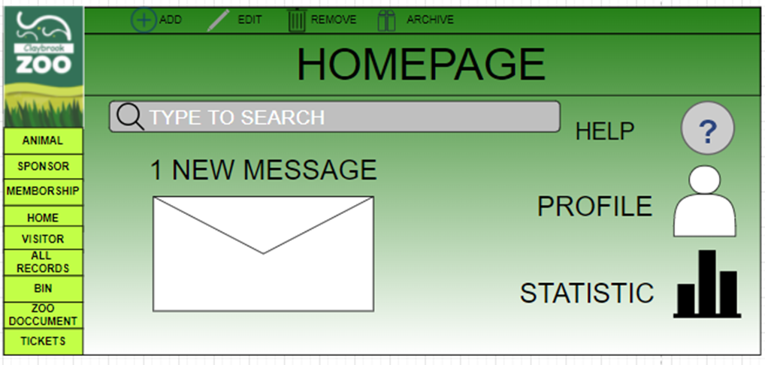
Start
Homepage displayed
User click on a button from different Options
Has user clicked on the any buttons
No?
Page of clicked button displayed
Stop

Slide 3
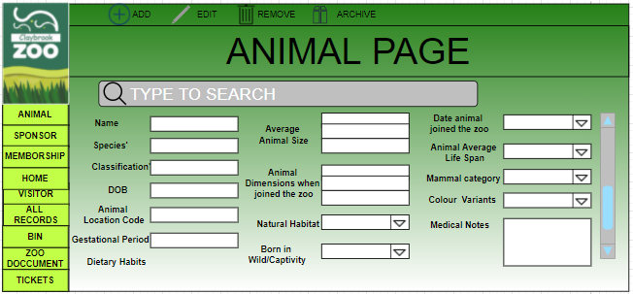
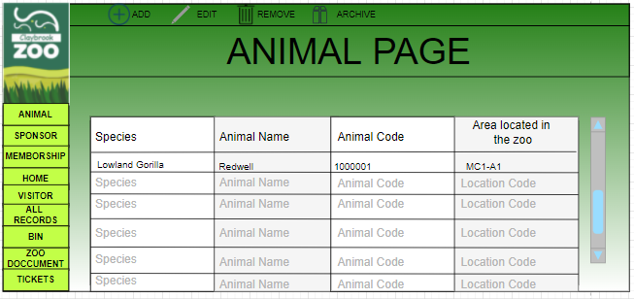
Start
Animal Records
Page
User clicks ADD
User clicks
Edit
Has user added or modified the animal data?
No
Yes
User click SAVE
Animal Data updated
Stop

Slide 4
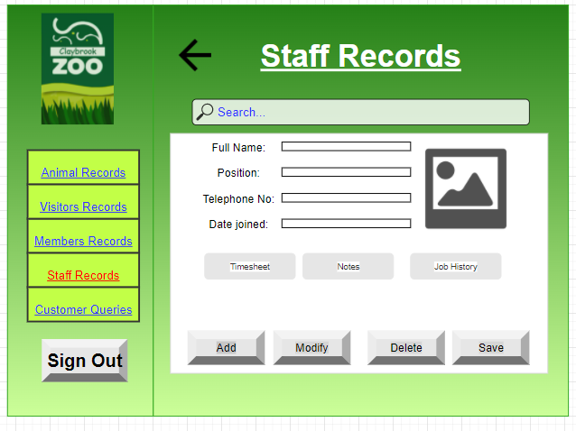
Start
Staff Records
Page
User clicks ADD
User clicks
Modify
Has user added or modified the animal data?
No
Yes
User click SAVE
Staff Data updated
Stop

Slide 5
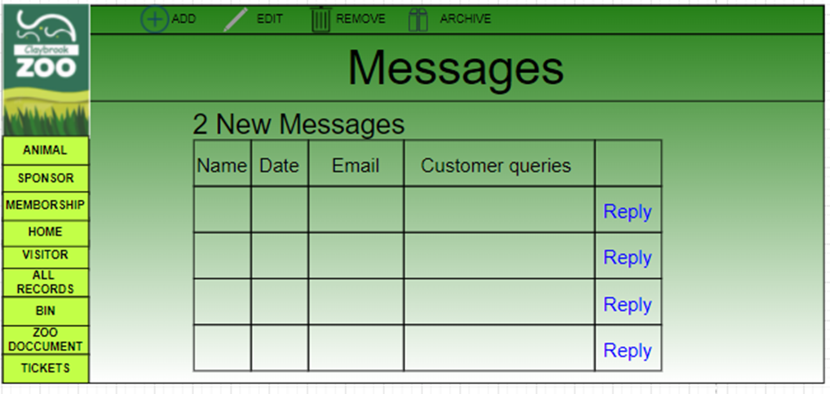
Start
Customer Query Page
User clicks send
Valid email address?
Error message
Message sent
Stop

Slide 6
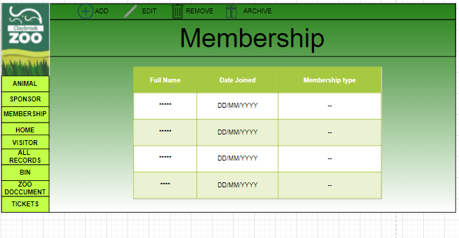
Start
Display
If User click on Remove or Archive
no
User clicked Removed?
User clicked archive?
no
Data removed
Data removed
Stop
Display updated
Stop

